Slide 1
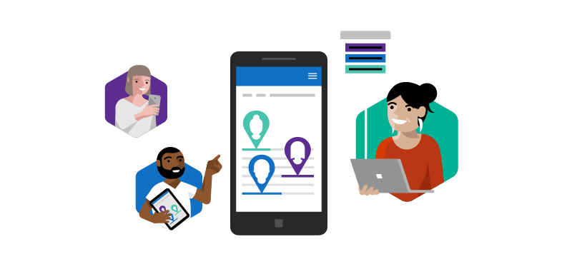
Microsoft Rapid Screening Solution V4 (2.0.0.X) Deployment Guide
April 26, 2021

Slide 2
VERSION 4 (2.0.0.X)
This release we are introducing home screening. Employees will be able to take advantage of a step-by-step approach guiding them from the intake of a sample through the input of the result. In the solution settings we are making it easy to enable home screening and input the desired consent verbiage.
Read on to find out the feature details!

Slide 3
Version 4 (2.0.0.X) - Features
Employee App
Solution Settings
Environment Variables
Home screening new menu
Employee home screening consent
Employee home screening attestation
Home screening steps by steps videos
Home screening timer
Home screening result view
Home screening result photo capability
Allow home screening
Need to attest for home screening
Photo mandatory for home screening
Home screening consent
Home screen wait time in minutes
Home screen time out in minutes
Dataverse
Home screening table to store steps, images and video links

Slide 4







Home Screening - User Journey
Employee selects
home screening
Employee
logs in the Employee App
Employee starts
the timer (ie. 15min to 2hours)*
Negative Screen:
Employee can go to work
Presumptive Positive Screen:
Employee gets PCR Test
Employee consents
to home screening
(also achievable through the Employee Profile)

Wait
Employee performs
home screening
Employee inputs result & takes photo*
Employee can watch training videos and attests*

Slide 5

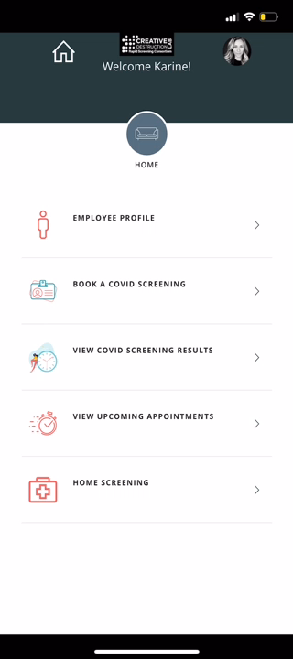
Home Screening - Demo
Notes:
The minimum timer was set to a few seconds for demo purposes.
The picture was taken with a pen for demo purposes, and it should be a test in reality.

Slide 6
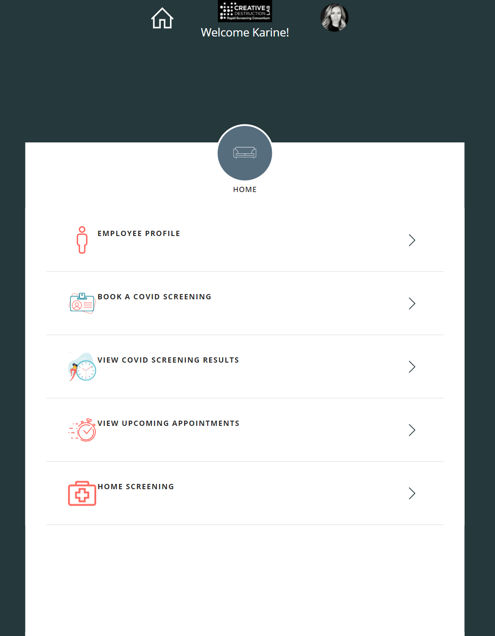
Employee App
Home screening new menu

Slide 7
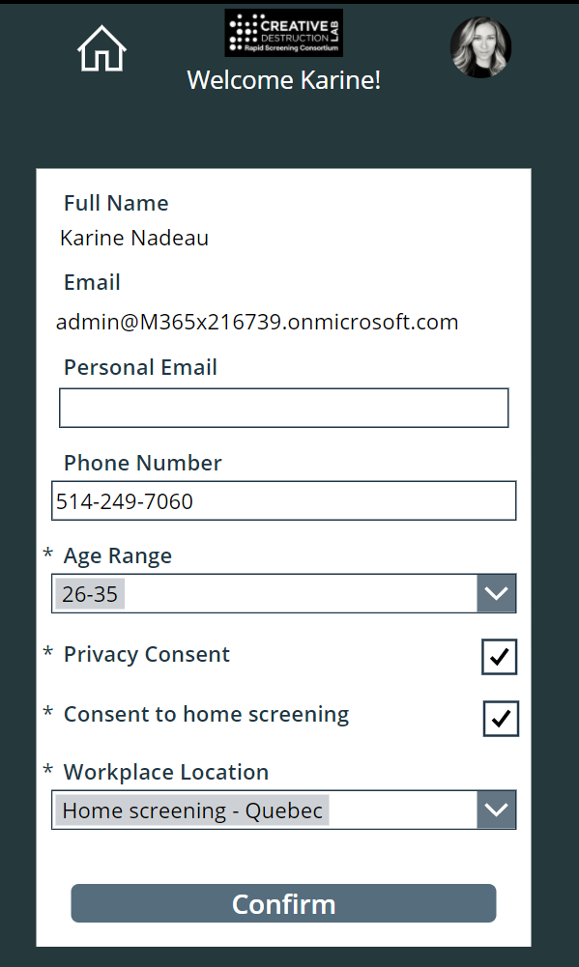
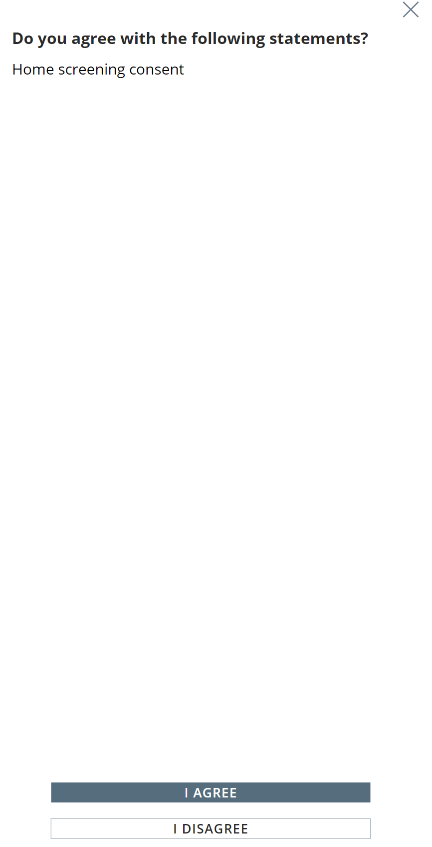
Employee App
Through the Employee profile
or
Employee must consent to home screening.
By clicking on HOME SCREENING

Slide 8
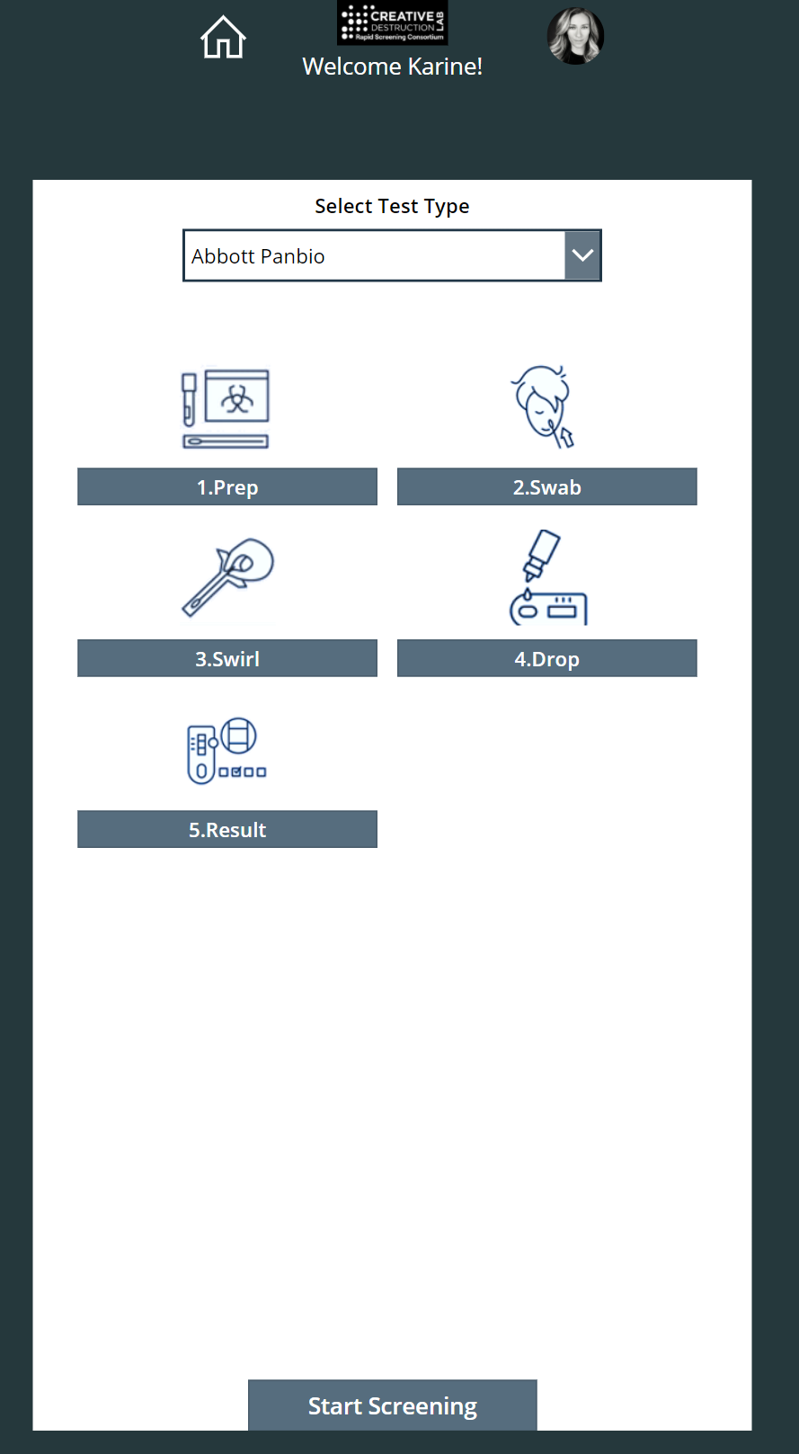
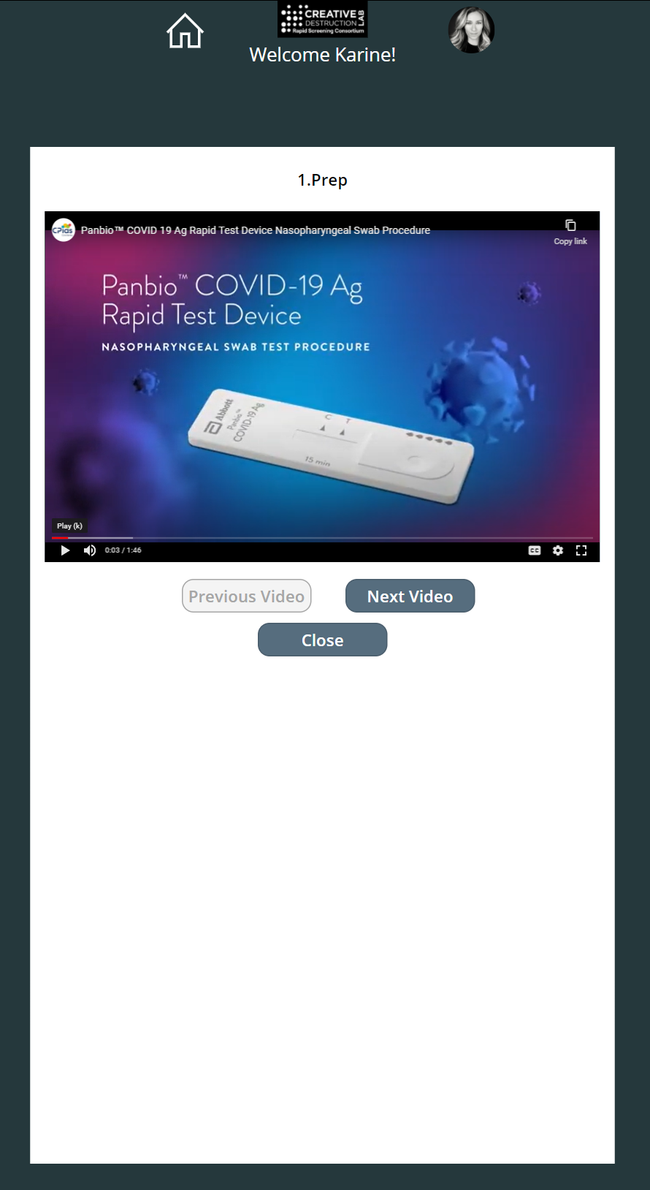
Employee App
Example using YouTube
Home screening steps-by-steps videos
Note: Videos can be made by your organization and be stored in either Microsoft Stream or Azure Media Services. If you prefer to use videos from an external source you can select YouTube. More details can be found in the “V4 Deployment Guide”.
2
1

Slide 9
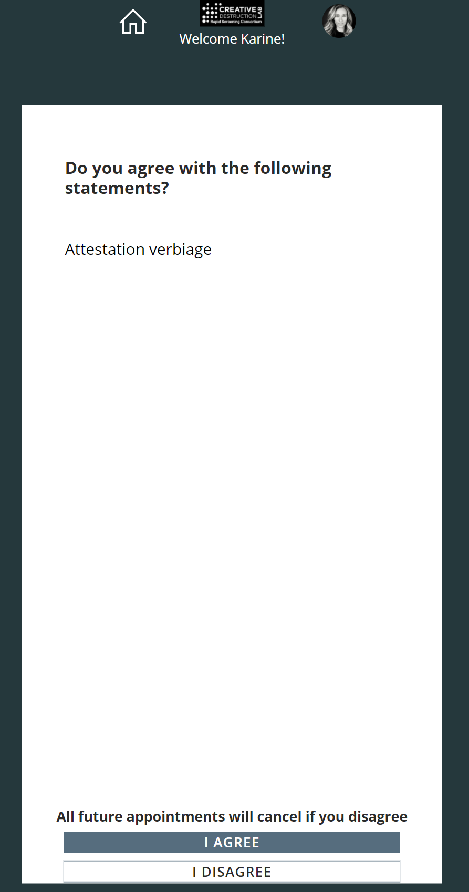
Employee App
Employee must attest to home screening
Note: Replace “Attestation verbiage by your organization attestation wording”.
2
1

Slide 10
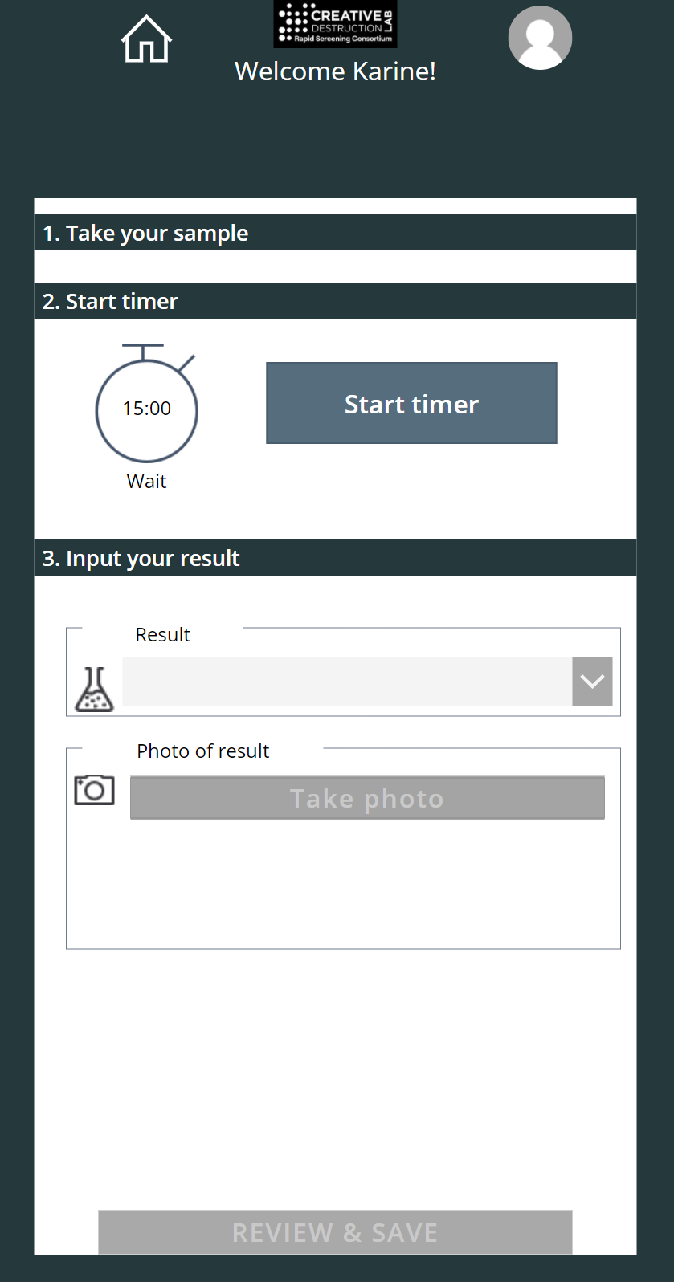
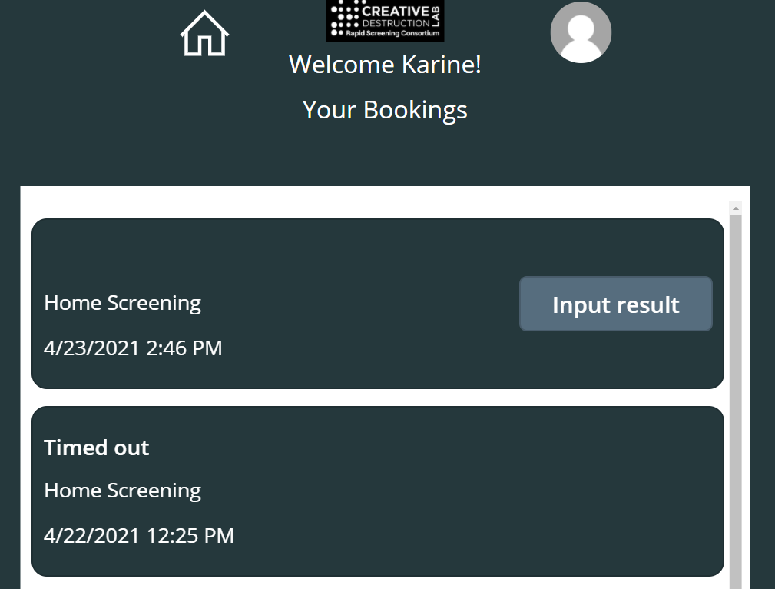
Employee App
Click on VIEW COVID SCREENING RESULTS to see this view
1. Home screening timer (result input minimum and maximum can be set).
2. Result view
ie. It takes minimum 15 minutes for the test to provide a result which is valid for a maximum of 2 hours.
Note: View “V4 Deployment Guide” to find out how to set it up.
2
1
Within the threshold so the user can still input their result
Outside of the threshold so the user can’t input their result and must start another screening

Slide 11
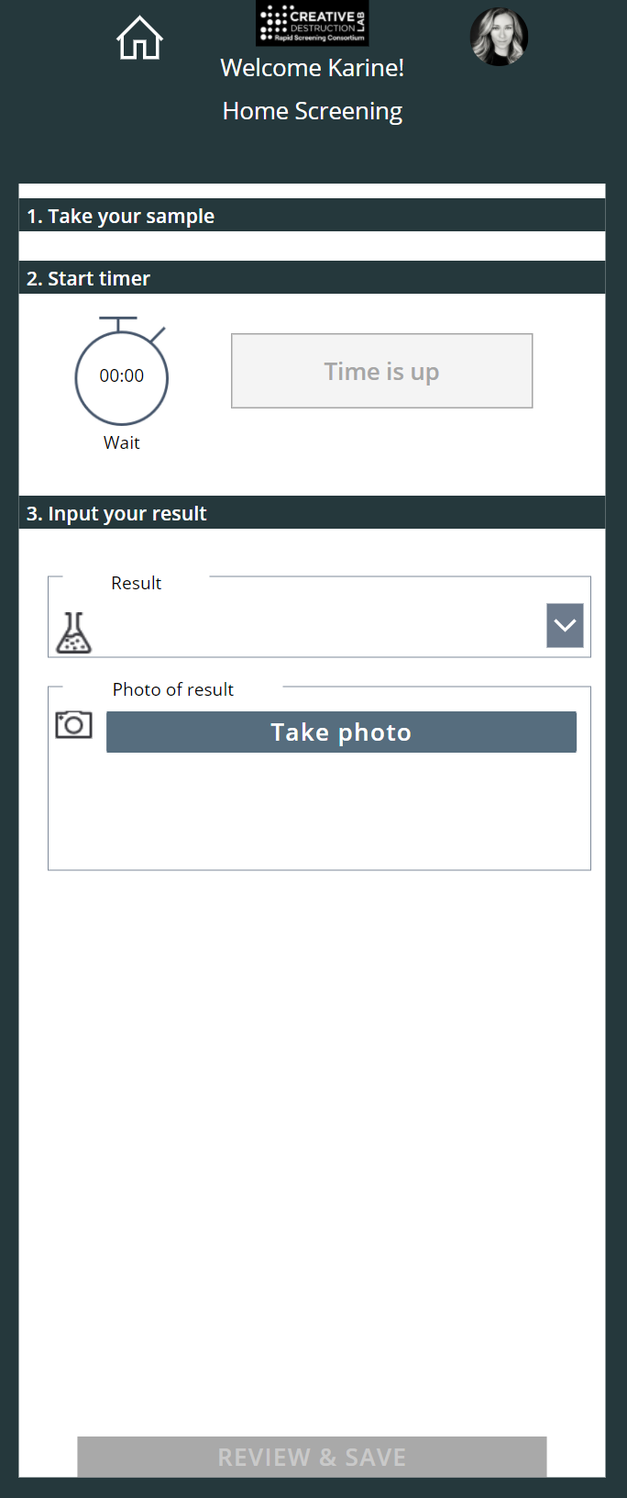
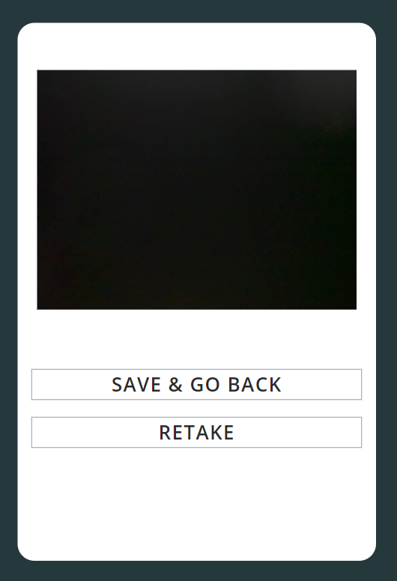
Employee App
Home screening result photo capability
2
1

Slide 12
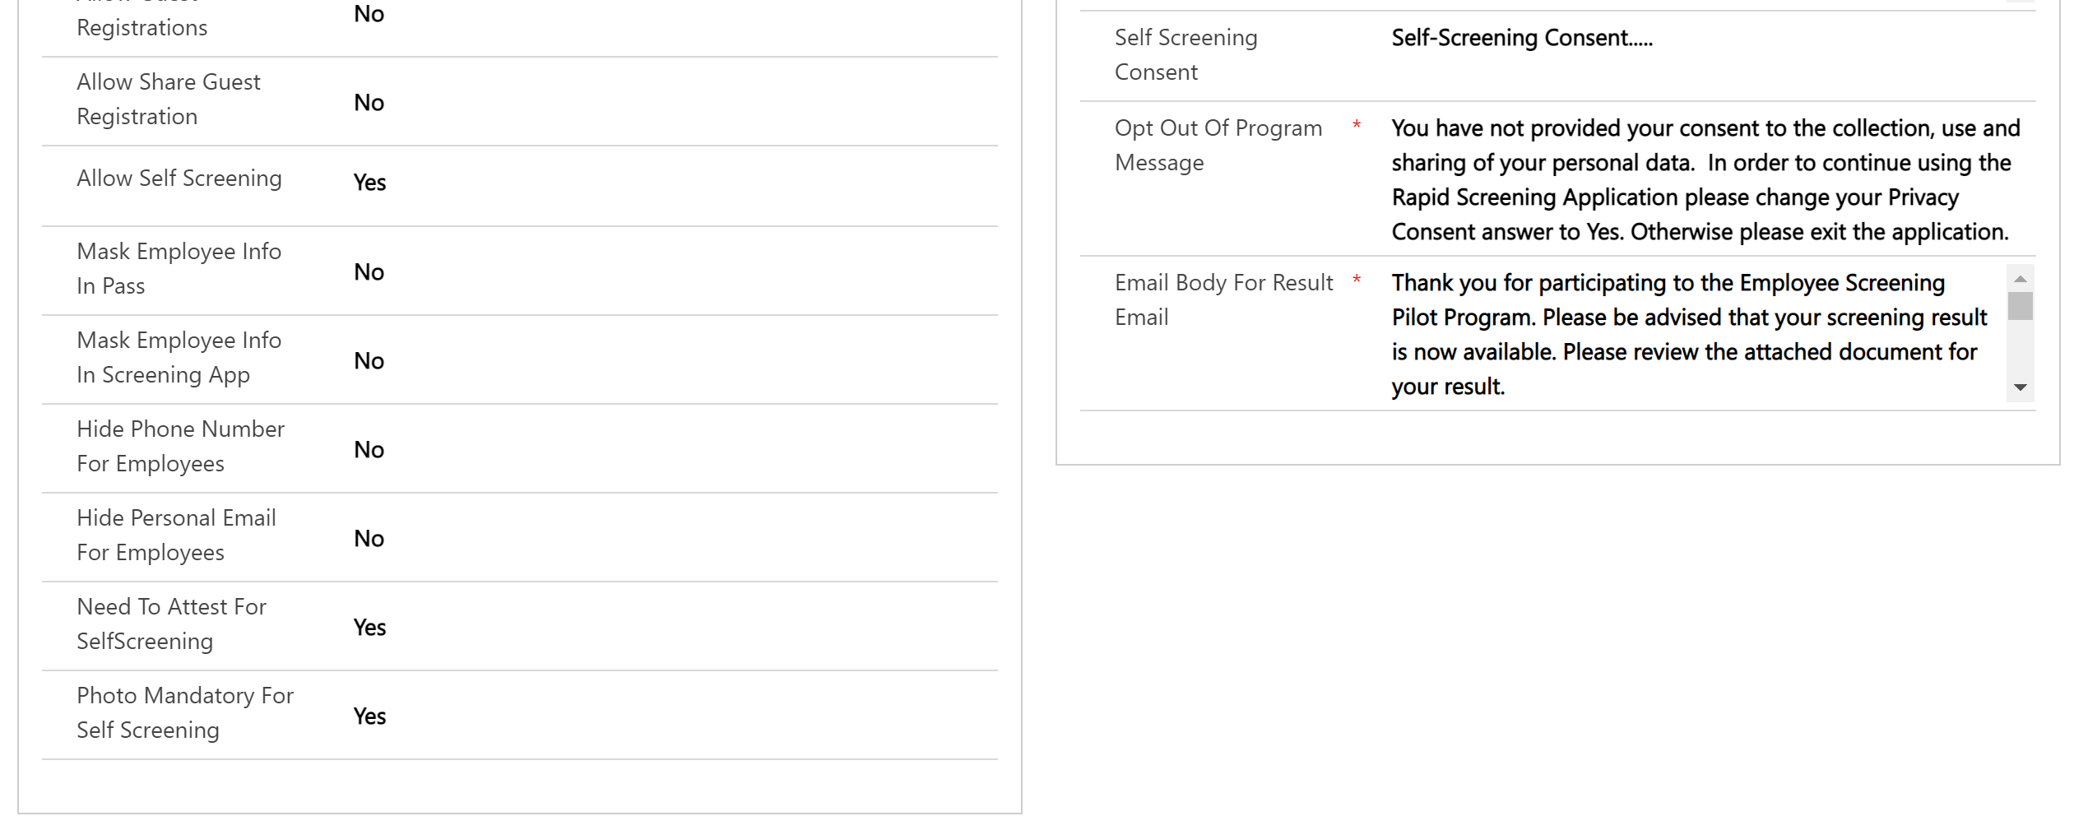
Solution Settings
1. Allow home screening Do you want to allow employees to do home screening yes/no?
2. Need to attest for home screening Must the employee performing home screening attest their symptoms?
3. Photo mandatory for home screening Must the employee performing home screening provide a photo of the test itself?
4. Home screening consent What is the home screening consent verbiage?
4
1
2
3

Slide 13

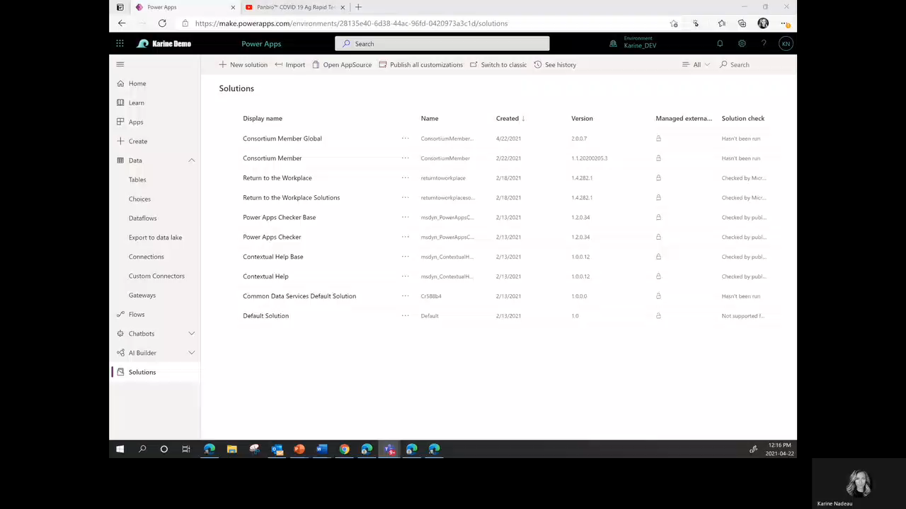
Dataverse
Home screening table to store steps, images and video links
Note: View “V4 Deployment Guide” to find out how to set it up.

Slide 14
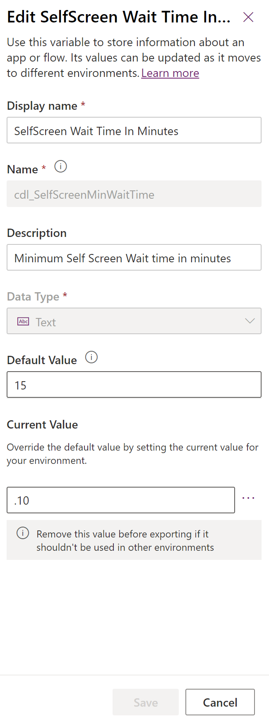
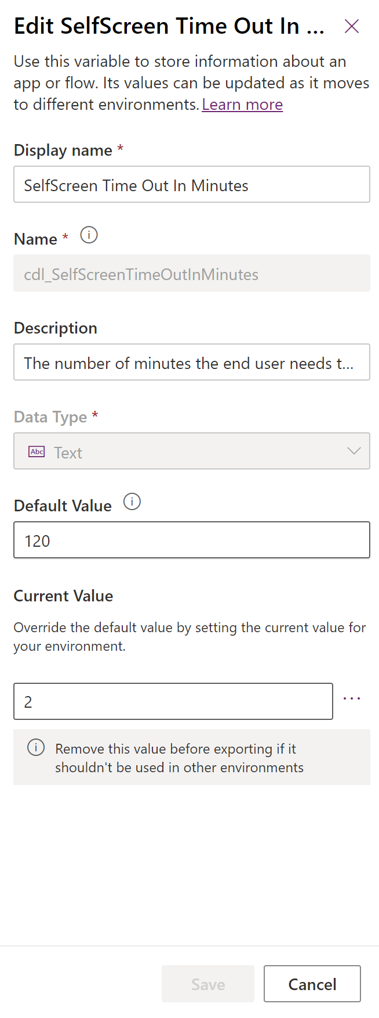
Environment Variables
1
2
1. Home screen wait time in minutes
2. Home screen time out in minutes
Note: View “V4 Deployment Guide” to find out how to set it up.

Slide 15
Feedback
We are always looking to improve our documentation. If you have feedback and/or suggestions, please email us at: RapidScreeningSolution@service.microsoft.com

